Slide 1

System Calls for File and Process Management
Team 1
21 이태우
21 임주환
Notes:
버츄얼박스와 우분투를 설치 데모영상입니다.

Slide 2
Contents
Virtual Address Space and Protection
Kernel & User Virtual Address Space
Load ELF
x86 (IA-32) Memory Protection
Mode Switch
x86 (IA-32) mode switch
Validation of pointers passed from user
Process Syscall and Synchronization
EXEC
Producer Consumer Problem
Implementation
WAIT & EXIT
Producer Consumer Problem
Implementation

Slide 3
Contents
Virtual Address Space and Protection
Mode Switch
Process Syscall and Synchronization
File Syscall and Synchronization
File System overview: FDT, File Object and Inode
Synchronizaion
Global Lock Strategy
Future Improvements
Implementation
Project Test

Slide 4
Default Virtual Address Space Layout
Virtual Addr Space
page dir
Physical Addr Space
A Virtual address space separated into two subspaces. When a page is installed to the page directory, PintOS set privilege of the page following the table below.
Default Page Directory only maps 64MB of Kernel Virtual Address Space to Physical Address Space.
~
~
~
~
~
~
~
~
0xc4000000
Kernel V-Addr Space
0xc0100000
Vaddr Space | Kernel | User
Address Range | 0xc0000000 - 0xc4000000 | 0x0 - 0xbfffffff
Privilege | 0(super) | 3(user)
0xc0000000
3GB
~
~
~
~
~
~
~
~
64MB
User Pool
User V-Addr Space
Kernel Pool
1MB
0x0
0

Slide 5
Process Execution - Load ELF
Virtual Addr Space
page dir
Physical Addr Space
process_execute() does the following tasks :
~
~
~
~
~
~
~
~
0xc4000000
Create a thread.
This thread serves as both the PCB and the kernel stack for the process.
Kernel V-Addr Space
The new thread performs start_process() procedure.
thread
Load segments from ELF to pages in User pool
3GB
~
stack
~
~
~
~
~
~
~
64MB
Install a mapping from the user virtual page to Fetched segments in User Pool
User Pool
User V-Addr Space
Allocate a page for user stack and paging it.
Kernel Pool
.bss .code .data
1MB
0x0
0

Slide 6
x86 (IA-32) Memory Protection
Virtual Addr Space
page dir
The kernel and the architecture must protect all virtual address space except for the segments explicitly allocated to the user.
There are two types of illegal access attempts:
Accessing a page that was never provided by the kernel to the user
Accessing the kernel address space
The x86 architecture automatically enforces protection against both of these types of violations by PAGE FAULT exception!
~
~
~
~
0xc4000000
Protect kernel code and data from
malicious or ignorant users.
Kernel V-Addr Space
Page fault at 0xc0103000:
rights violation error
thread
access trial in user context
~
stack
~
~
~
access trial in user context
User V-Addr Space
Page Fault at 0x20000000
not existing page error
.bss .code .data
Deny access to pages not managed
by the page management system.
0x0

Slide 7
Mode Switch for System Call (1/5)
Virtual Addr Space
In the user context, EIP and ESP point to the user code and user stack, respectively.
~
~
Kernel stack
~
~
Kernel V-Addr Space
DPL field of CS register represents current privilege leve (CPL) and in the user context, CPL is 3
IDT
TSS
0x30
esp0
ss0
thread
...
~
stack
~
~
~
The 0x30 entry in the IDT points to kernel code, and the esp0 field in the TSS points to the kernel stack.
registers
eip
esp
cs.dpl=3
User V-Addr Space
User stack
.bss .code .data
0x0

Slide 8
Mode Switch for System Call (2/5)
Virtual Addr Space
Arguments and the system call number are placed on the user stack.
And ‘int 0x30’ is invoked.
~
~
Kernel stack
~
~
Kernel V-Addr Space
IDT
TSS
0x30
esp0
ss0
thread
...
~
stack
~
~
~
registers
eip
esp
cs.dpl=3
User V-Addr Space
User stack
args
.bss .code .data
sys_num
0x0

Slide 9
Mode Switch for System Call (3/5)
Virtual Addr Space
Arguments and the system call number are placed on the user stack.
And ‘int 0x30’ is invoked.
~
~
Kernel stack
~
~
Kernel V-Addr Space
EIP is set to the interrupt handler address, and CPL is promoted to 0.
IDT
TSS
0x30
esp0
ss0
thread
...
~
stack
~
~
~
registers
eip
esp
cs.dpl=0
User V-Addr Space
User stack
args
.bss .code .data
sys_num
0x0

Slide 10
Mode Switch for System Call (4/5)
Virtual Addr Space
Arguments and the system call number are placed on the user stack.
And ‘int 0x30’ is invoked.
~
~
Kernel stack
~
~
...
usr esp
...
usr eip
Kernel V-Addr Space
EIP is set to the interrupt handler address, and CPL is promoted to 0.
IDT
TSS
0x30
esp0
ss0
thread
...
ESP is changed to the top of the kernel stack, and The user context's EIP and ESP are saved on the kernel stack.
~
stack
~
~
~
registers
eip
esp
cs.dpl=0
User V-Addr Space
User stack
args
.bss .code .data
sys_num
0x0

Slide 11
Mode Switch for System Call (5/5)
Virtual Addr Space
Arguments and the system call number are placed on the user stack.
And ‘int 0x30’ is invoked.
~
~
Kernel stack
~
~
...
usr esp
...
usr eip
Kernel V-Addr Space
EIP is set to the interrupt handler address, and CPL is promoted to 0.
IDT
TSS
0x30
esp0
ss0
thread
...
ESP is changed to the top of the kernel stack, and The user context's EIP and ESP are saved on the kernel stack.
~
stack
~
~
~
registers
eip
esp
cs.dpl=0
User V-Addr Space
User stack
args
All of this is performed automatically by the x86 architecture!
.bss .code .data
sys_num
0x0

Slide 12




Validate pointers passed from user
When entering a system call handler, the CPU switches to privilege level 0
The syscall handler performs operations on memory regions specified by the user.
This combination — kernel-level privileges plus user-specified memory — effectively bypasses the architectural protection mechanisms.
Therefore, the kernel must be smart enough to distinguish between legitimate faults and those caused by invalid user requests.
Validate it!

Slide 13

Validate pointers passed from user
exec (char *cmd_line)
create (char* file_name, int init_size)
remove (char* file_name)
open (char* file_name)
read (int fd, void *buffer, unsigned int size)
write (int fd, void *buffer, unsigned int size)
validation of space [usr esp, usr esp + argc]
Fixed
Buffer Size
Variable
Buffer Size
kernel
kernel
kernel
kernel
kernel
v-addr
space
invade
ptr
size
........
........
$$⊂$$
base
str
COMPUTER
NETWORK
\0
ptr
size
access to
unmapped
page
str
base
COMPUTER
user
user
user
user
validation procedure
validation procedure
void
validate_uaddr_space (const void *base, unsigned int size)
int
validated_strlen (const char *str)

Slide 14


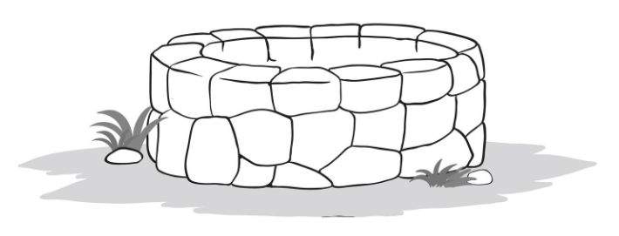
EXEC System Call
A child process loads an ELF binary and stores the result in elf_load_status.
The parent process checks the child's elf_load_status whether the ELF file was successfully loaded.
The child acts as the producer of elf_load_status, while the parent is the consumer.
This situation represents a classic producer-consumer problem involving shared memory.
parent
child
ELF
File System

Slide 15

Synchronization for EXEC Syscall
Create child thread
elf_load_status
==SUCCESS?
Get elf_load_status
P(‘child’->elf_load)
EXEC()
F
return -1
T
is successful?
Set elf_load_status
=SUCCESS
return
‘child’->tid
Child thread
T
F
V(self->elf_load)
Load ELF File
Parsing & Passing
Initialize FDT
Set elf_load_status
=FAIL
mode switch
(K→U)
call EXIT
thread
elf_load_status
process
segs.
child process to execute
Completely loaded

Slide 16
Implementation EXEC Syscall
enum elf_load_status
{
ELF_NOT_REQUESTED,
ELF_LOADING,
ELF_LOAD_SUCCESS,
ELF_LOAD_FAILED
};
pure kernel
thread
ELF_NOT_REQUESTED
thread
instance
load-success
process
process
ELF_LOAD_SUCCESS
ELF_LOADING
load-failed
process
ELF_LOAD_FAILED
struct thread {
...
struct semaphore sema_elf_load;
enum elf_load_status elf_load_status;
struct file *elf_file;
...
};
Semaphore for conditional synchronization.
Shared variable represents ELF loading result
of created child process
Held ELF file object to prevent it from being
modified on runtime

Slide 17
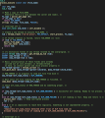
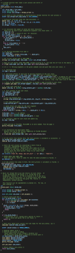
Implementation EXEC Syscall
process_execute ()
start_process ()
tid = thread_create ("on-ld procs“,
PRI_DEFAULT, start_process, fn_copy);
new_thread->elf_load_status = ELF_LOADING;
sema_down (&new_thread->sema_elf_load);
if (!load (exec_name, &if_.eip, &if_.esp))
goto start_process_fail;
if (new_thread->elf_load_status
== ELF_LOAD_SUCCESS)
{
ret = tid;
}
else if (new_thread->elf_load_status
== ELF_LOAD_FAILED)
{
process_wait (tid);
ret = -1;
}
char *arg_contents_part
= (char *)if_.esp - (char_cnt + 1);
char *word_align_part
= arg_contents_part - ((uint32_t)arg_contents_part % 4);
char **argv_entries_part
= (char **)word_align_part - (argc + 1);
uint32_t *stk_top
= (uint32_t *)argv_entries_part - 3;
cur_thread->elf_load_status = ELF_LOAD_SUCCESS;
sema_up (&cur_thread->sema_elf_load);

Slide 18



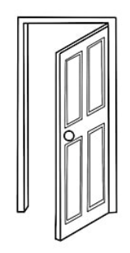
WAIT, EXIT System Call
The child process releases the resources in its own user space, but retains its kernel thread, including the exit_status. (Zombie)
The parent process accesses the child's exit _status and then deallocates the remaining resources of the child. (Reaping)
The child is the producer of the exit_status, and the parent is the consumer.
A producer-consumer problem!
parent
exit
status
child

Slide 19
Synchronization for WAIT, EXIT Syscall
return -1
does target ‘child’ exist
Get exit_status
F
Reap ‘child’
P(‘child’->wait)
WAIT()
return
exit_status
if (orphan)
EXIT()
F
T
V(self->wait)
never
return
Reap Or Abandon
Children
Destroy user v-addr space
Reap itself
never
return
Set status=ZOMBIE
Set exit_status
thread
exit_status
process
segs.
child process to exit
zombie process
Completely Destroyed

Slide 20
Implementation WAIT, EXIT Syscall
enum thread_status
{
THREAD_RUNNING,
THREAD_READY
THREAD_BLOCKED
THREAD_DYING,
THREAD_ZOMBIE // [+]
};
start
THREAD_
READY
THREAD_
RUNNING
THREAD_
ZOMBIE
THREAD_
DYING
THREAD_
BLOCKED
struct thread {
...
struct semaphore sema_sys_wait;
int exit_status;
...
};
Semaphore for conditional synchronization.
Shared variable storing exit status of child process

Slide 21

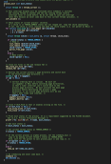
Implementation WAIT, EXIT Syscall
process_wait ()
process_exit ()
if (child->status == THREAD_ZOMBIE) {
/* Reap */
list_remove (&child->child_elem);
list_remove (&child->allelem);
child->status = THREAD_DYING;
palloc_free_page (child);
} else {
/* Make orphen */
child->parent = NULL;
}
sema_down (&child->sema_sys_wait);
int exit_status = child->exit_status;
list_remove (&child->child_elem);
list_remove (&child->allelem);
child->status = THREAD_DYING;
palloc_free_page (child);
t->pagedir = NULL;
pagedir_activate (NULL);
pagedir_destroy (pd);
t->exit_status = exit_status;
t->status = THREAD_ZOMBIE;
if (t->parent == NULL) {
t->status = THREAD_DYING;
}
else {
sema_up (&t->sema_sys_wait);
}

Slide 22
File management
Process A
fd 0
fd 1
fd 2
fd 3
fd 4
fd 5
File object
File A
Data
inode struct
File A
Data
File descriptor table
File object
Process B
File A
Data
File object
File B
Data
inode struct
File B
Data
fd 0
File object
fd 1
File B
Data
fd 2
fd 3
file table
inode table
Disk
fd 4
fd 5
File descriptor table

Slide 23
Layered File System in RTEMS
Application logic
Libbsd network
filesystems
File interface
Logical filesystem
Libnetworking
filesystems
VFS
IMFS
M-MIMFS
YAFFS2
JFFS2
RFS
DOSFS
DEVFS
Buffer,cache
Device driver

Slide 24
File descriptor table
Add a File Descriptor Table(FDT) as a member to the thread struct
int process_add_file(struct file *f) : Add a file object to the FDT and returns the newly assigned file descriptor.
struct file* process_get_file(int fd) : Retrieves a file object from the FDT using a file descripor
struct thread{
…
struct file* fd_table[FDTABLE_SIZE]
…
}
process_add_file(file){
…
for(i=3, i<FD_SIZE,i++){
…
if(fd_table[i]==NULL){
fd_table[i]=file
return i
}
process_get_file(fd){
…
Thread* t = thread_current()
return t->fd_table[fd]
}
thread.h
process.c
process.c

Slide 25
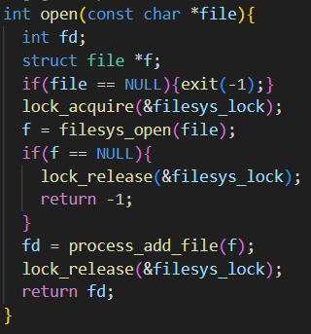
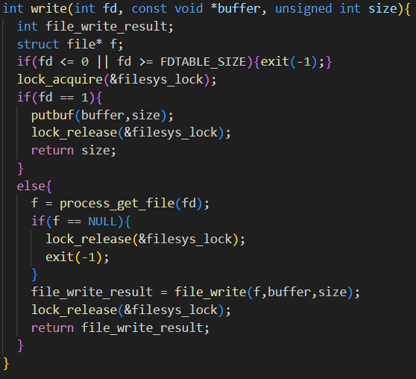
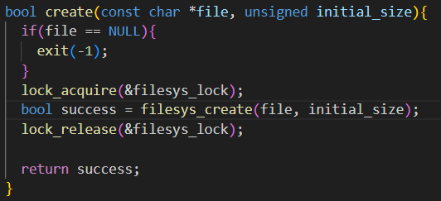
filesys_lock
A single global lock, filesys_lock, protects the entire file system
Every file system operation(open,create,write,etc.)must acquire this lock before proceeding.
This strategy serializes all file system access, preventing any concurrent operation

Slide 26

synchronization
Process A
fd 0
Lock
fd 1
fd 2
fd 3
fd 4
fd 5
File object
File A
Data
Inode struct
File A
Data
File descriptor table
File object
Process B
File A
Data
File object
File B
Data
Inode struct
File B
Data
fd 0
File object
fd 1
File B
Data
fd 2
fd 3
file table
inode table
Disk
fd 4
fd 5
File descriptor table

Slide 27
synchronization(filesys_lock)
Advantage
Simplicity of implementation
The code is clean and intuitive because only a global lock(filesys_lock) needs to be managed.
Robust safety
Disadvantage
Performance Bottleneck
Low Concurrency
Unnecessary waiting occurs even when processes access different, non-conflicting files, nullifying the benefits of a multi-process environment.
Improvement plan
Instead of global lock, acquire a lock on a per-inode basis when reading or writing a file
Allows a concurrent operations on different files, significantly increasing system parallelism and overall throughput

Slide 28
create
bool create(const char *file, unsigned initial_size)
Create file which has size of initial_size
Use bool filesys_create(const char *name, off_t initial_size)
Return true if it is succeeded or false if it is not
Create the file on disk only, it is not loaded into memory.
Create!
filesys_create()
File metadata
File
data
File
data
File
data
File
data
Disk
Disk

Slide 29
open
int open(const char *file)
Finds the sector number on disk where the file’s on-disk inode is stored
Return fd using process_add_file(f)
Use struct file *filesys_open(const char *name).
Connect!
Connect!
Process A
Inode_open()
Create!
Create!
fd 0
File metadata
fd 1
File object
fd 2
inode struct
fd 3
File
data
fd 4
File
data
fd 5
File
data
Connect!
File
data
File descriptor table
memory
Disk
file table

Slide 30
read
int read(int fd, void *buffer, unsigned size)
Read size bytes from the file open as fd into buffer.
Return the number of bytes actually read(0 at end of file), or -1 if fails
If fd is 0, it reads from keyboard using input_getc(void), otherwise reads from file using file_read(file,buffer,size) function
File metadata
size
File data
File data
File data
File
data
File
data
File
data
buffer
File
data
Vaddr space
Disk

Slide 31
write
int write(int fd, const void *buffer, unsigned size)
Write size bytes from buffer to open file fd.
Return the number of bytes actually written.
If fd is 1, it writes to the consol using putbuf(buffer,size), otherwise write to the file using file_write(file,buffer,size) function
File metadata
size
File data
File data
File data
File
data
File
data
File
data
buffer
File
data
Vaddr space
Disk

Slide 32
filesize, seek, tell
int filesize(int fd)
Return the size, in bytes, of the file open as fd.
Use off_t file_length(struct file*file)
void seek(int fd, unsingned int position)
Change the next byte to be read or written in open file fd to position.
Modifies the pos member within the struct file.
Use void file_seek(struct file *file, off_t new_pos)
unsigned tell(int fd)
Return the position of the next byte to be read or written in open file fd.
Use off_t file_tell(struct file *file)

Slide 33
close
void close(int fd)
Close file descriptor fd.
Use void file_close(struct file *file).
The inode struct is deallocated only when closed by its last user.
Process A
fd 0
File metadata
fd 1
File object
fd 2
inode struct
fd 3
File
data
fd 4
File
data
fd 5
File object
File
data
File
data
File descriptor table
memory
Disk
file table

Slide 34
remove
bool remove (const char *file)
Remove file whose name is file
Use bool filesys_remove(const char *name).
Return true if it is succeeded or false if it is not.
File is removed regardless of whether it is open or closed.
Process A
fd 0
fd 1
File metadata
File metadata
fd 2
fd 3
File
data
File
data
File
data
fd 4
File
data
File
data
File
data
File
data
File
data
fd 5
Disk
Disk
File descriptor table
Case 2
Case 1

Slide 35
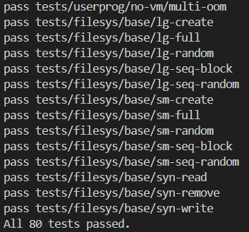
Test
Process management test
exec-once : verifies that a single child process can run and exit correctly.
wait-simple : checks that a parent can wait for a child and get its correct exit code.
File management test
open-normal : tests the successful opening of an existing file.
read-normal : checks that reading from a file returns the correct data.
write-normal : confirms that writing to a file and reading it back works correctly

Slide 36
Thank You!

